Slide 1



Gargash Hackathon 2025
NEURAL DRIVE
Raj Rangwani
Ruhan Goltay
Divya Kishor

Slide 2

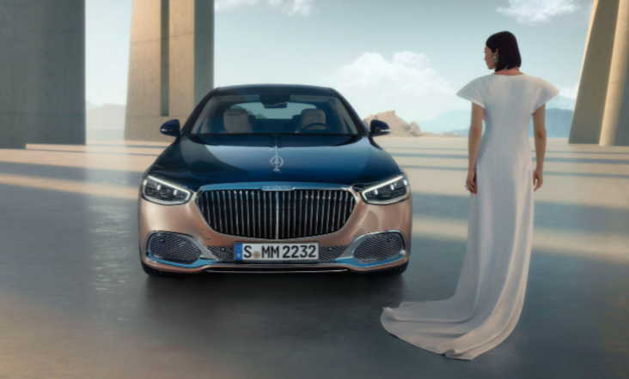
ENABLING DREAMS
Financial Planner
Optimize spending and saving
Live alerts on market price data
Cross selling Gargash real estate rentals
Offer investment services

Slide 3

ROAD TO RIDE
01
02
03
04
Agentic AI
SnowFlake
ML Regression
NLP Alerts
Live market data of preowned car prices
Bank API with spending statistics
User Financial Profile
User goals and forecasts
Recommended Spending Patterns
Promote Gargash services

Slide 4
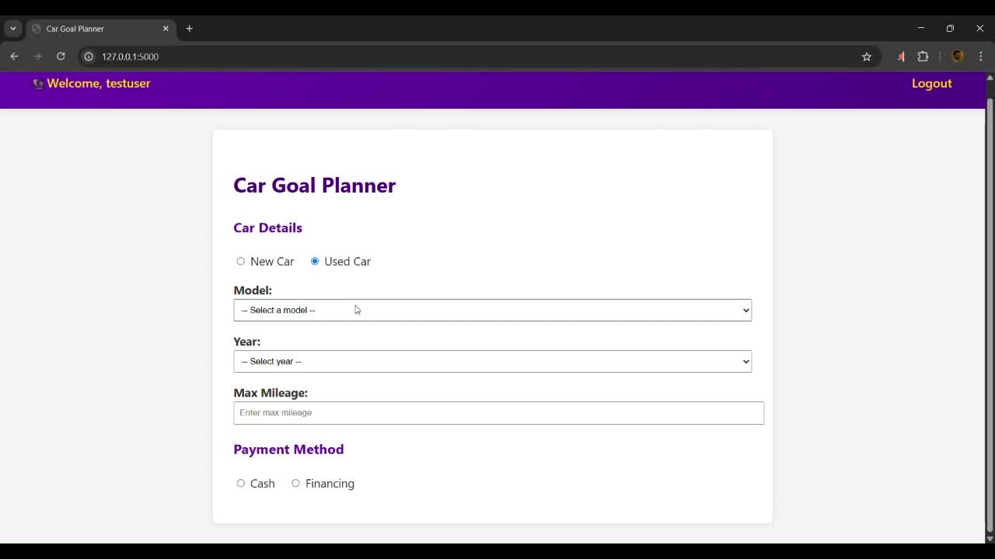
PROTOTYPE

Slide 5

FORWARD DRIVE
Additional Deep Learning Models
Predict customer financial health (income, home rent) based on bank transactions data
NLP Integrated Communication
Personable and effective interactions with customers

